Slide 1


CAPSTON PROJECT-1 Play Store App and Review analysis
By
balkrishna Tiwari

Slide 2






WHY APPS SO IMPORTENT
Advent of Digital technology
2. Goverments push towards digital economy and e-governance
3. Flow of app on app store
4. User base for apps
5. Popularity of apps
6. Users behavior on specific apps
Number of smartphone users have increased to 6.8billion in 2023 as against 3billion in 2016.
With less then 45% penetration India is still has the 2nd largest smartphone users.
Average mobile computation power has reached to 2.2Ghz in 2023 against 100MHz in 2000.
Multy core CPUs are used in mobile now.
GOI has pushed its government policy's linked with Aadhar infra.
UPI Payment has ensured seamless digital transactions.
Most of ministries have dedicated app for users.
Entertainment apps like tiktok have attracted most number of users.
Easiness of payment transaction has made Paytm known to everyone.
There has been shift in average user age and trend and hence the expectations have increased or changed.
Number of users are concentrated on small number of apps.
1. Number of app on the google app store has increased from 400K in 2012 to 2.65Million in 2023.
2. App business has stood at 106Billion in 2018 and expected to reach till 407Billion.

Slide 3
Introduction
With the advancement and spread of Information and digital technology, usability of mobile phones among common people have increased drastically.
The resent push of governments for digital economy and governance has also boosted use and popularity of smart phones.
We have seen growth in use of smart phones among masses which is now not limited to only youngsters but have found interest of users belonging to all ages.
Apps are the categorized feature segments of mobile that is designed to function and accomplish specific purpose. These purpose very according to needs of the user, like payments app is designed to carryout seamless transactions of digital payments with quickness coupled with integration of banking transactions and record keeping features simultaneously.
Android has became the most popular operating system in the world, with more then 4billion active users throughout the world. Number of apps running on Android and google OS has drastically increased year on year and android dominates the market share in terms of number of mobile operating on Android.
With wide variation of audience there is wide demand of categories. And since there is high demand for app that has attracted large number of developers and companies to try their hand in app building business. But as most of the apps are free to use, the best one is selected from among the pool of supplies in same category. So, it has become very important for developers to check historical trends about the performance of app, and to apply insights from analysis to make their own business decision.
Data science is the field that helps to extract logical details of bulk data and funnels them to conclusive remarks or results. The main aim will be to get detailed insights about the behavior of variables and its effect on rating and reviews, that ultimately drives apps acceptance within its users. Based on results we would also be suggesting certain key points that need to be considered while designing or launching a new app on app store.

Slide 4


Problem Statement
We have two data sets namely App data and Review data. Our approach is to check these data sets for there integrity and correctness, apply suitable transformations and cleaning on them and visualize trends that will reinforce our knowledge to predict optimum variable values that an app developer should adopt in order to release a successful new app on app store. We will be answering following technical and business query based on analysis above.
1. Which category of apps are performing better in terms of rating.
2. What is the best category that has received highest installations.
3. What are the market gaps that can be harnessed with launch of new apps.

Slide 5
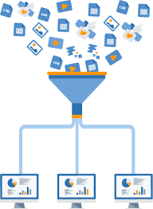
Refining raw data to Values
Loading the data sets: There are two datasets, Play store app dataset and User Reviews dataset.
Import Libraries: NumPy, Pandas, Seaborn and Matplotlib were imported to use during analysis.
Data cleaning: Null values, Finding and removing Outliers, Removing duplicate data.
Data Imputation: Checking for missing categorical and numerical values and application of suitable transformation to convert them into standard format.
Exploratory Data Analysis: Analyzing the data sets to summarize their main characteristics using statistical graphics and data visualizations method.

Slide 6

App Data and its Attributes
App: This column contains name of the app in string format.
Category: Category of the app is defined as the broad subject that the app aims to cover for. These values are again mentioned in string format.
Rating: It reflects value of aggregated rating received by an app from all reviews. Logically this rating should not be greater then 5 and should not be greater then 1, but there may be case were app is never been rated in such case only app may contain null value for rating.
Reviews: It contains number of reviews given to particular app. The value mentioned is not a simple number but number prefixed with M or K, which stands for million and thousands respectively. The values are mentioned as string.
Installs: It specifies apps category based on number of installs made by user for particular app. No exact number is given instead categorization is done as 10+, 100+, 1000+ and so on.
Type: This column specifies whether particular app is paid or free. Value mentioned as string.
Price: It gives the value or price applicable to user in order to install or buy particular app. The values mentioned is float number prefixed with currency symbol, which in this case is $. The final value is mentioned as string.
Content Rating: It categorizes the app based on target audience age suitable to use app.
Genres: It categorizes app based on genres associated with the app. There may be multiple genres category on single app.
Last Update: This column mentions last update date of the app.
Current Version: The column specifies current version of app available on app store.
Android version: It specifies the least android version required to run the app on mobile.

Slide 7

Review Data and its Attributes
App: This column contains the name of app in short description. The format is similar to App data set and is in string.
Translated Reviews: This column contains translated reviews of users translated in English and is mentioned in string format.
Sentiment: This column mentions categorization of translated reviews based on fact that comment is positive, negative or neutral.
Sentiment Polarity: Score of review based on its polarity towards positive or negative sentiment. Most negative sentiment have value of -1 while most positive comment will get value of +1, 0 polarity means neutral comment.
Sentiment subjectivity: Score of review based on its content registering subject matters.

Slide 8
Data Cleaning and Standardization
Inspecting App Data: Head and info methods were applied on both data to get first view of data set.
Understanding Variables: By applying describe method on data set and unique method on each column of data set, we got an understanding of how the values are placed within each column of dataset.
Standardization of column variables: Unit of measurement of column Size and Reviews was different within columns. I have utilized custom defined function and converted values of Size to MB only and Reviews to Numbers only. Similarly values in Installation column was standardized to numbers and that of Update date to Timestamp.
Manipulated columns: Some columns have descriptive details that can not be converted into numbers or unique single data directly, I have manipulated them to convert their values either in single number or single value. I have extracted lowest version number for android version, extracted first genres as primary genres.
Subcategorization based on values: I have also subcategorized apps based on value and its distribution within columns. With number of reviews being highly distributed throughout big span, app has been categorized into Very high reviews, High reviews, Medium Reviews, Low Reviews and Very low reviews. Similarly, I have categorized Rating and size of app too on similar pattern.
Exclusion of Rows: There are certain rows that are not required for analysis that has been dropped out of data frame. There is one row that have size value mentioned as 1000+, which is dropped from data frame. There are 1173 apps with duplicate name, I have removed some of duplicate data by using drop_duplicate() method and in next step shorted data for rating and excluded app name duplicates using drop_duplicate() function considering app name as subset and keeping only first record. For App review data frame around 26868 rows do not have translated reviews, and hence has been dropped from final data frame.

Slide 9
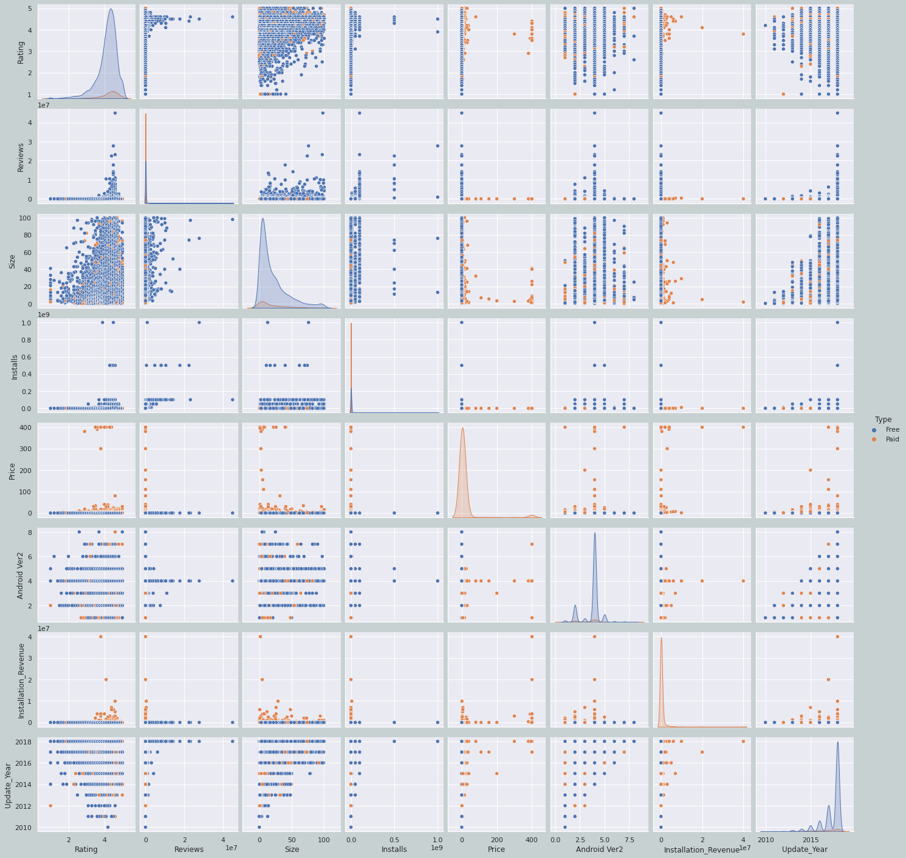
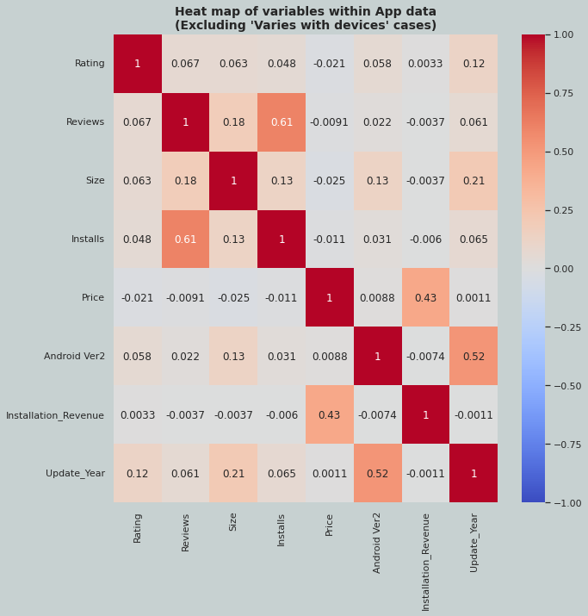
Pairwise variable plot (After excluding Varies with device cases)

Slide 10
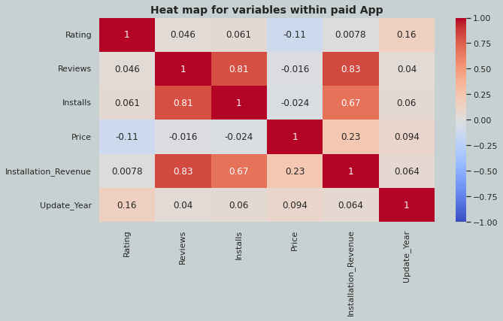
Correlation heat map for variables within paid app only

Slide 11
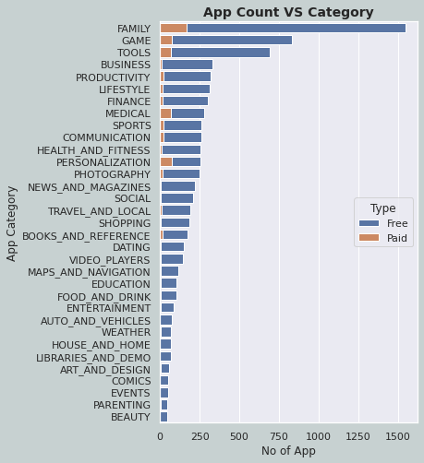
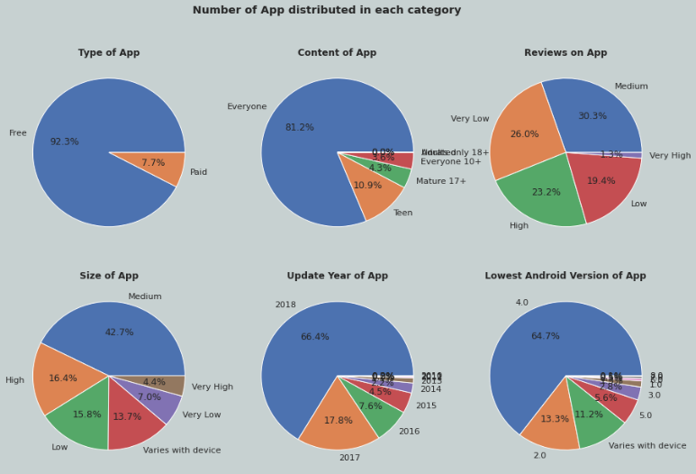
Number of apps available in each category

Slide 12
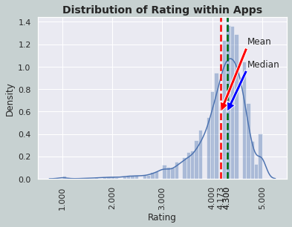
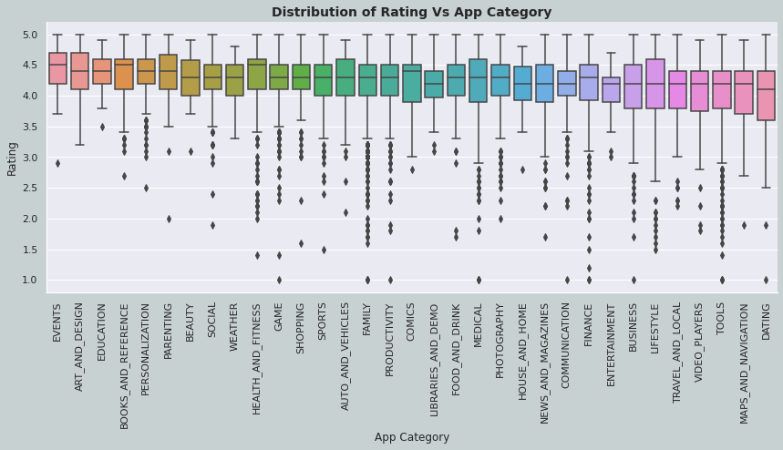
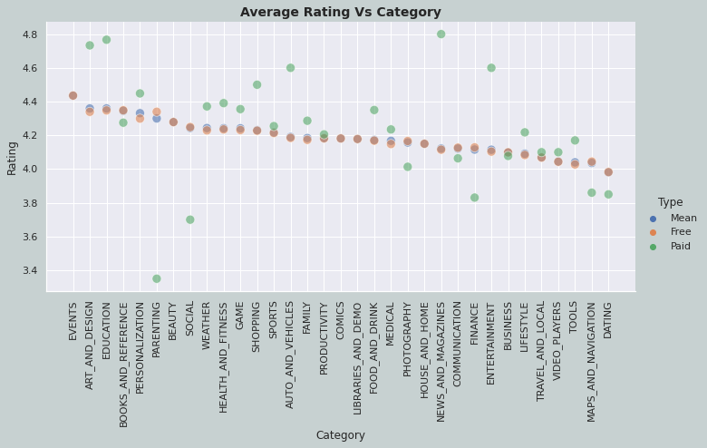
Rating distribution within apps

Slide 13
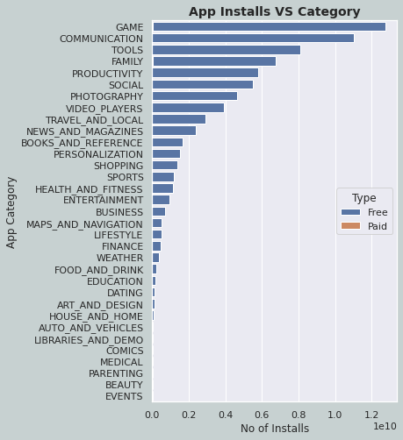
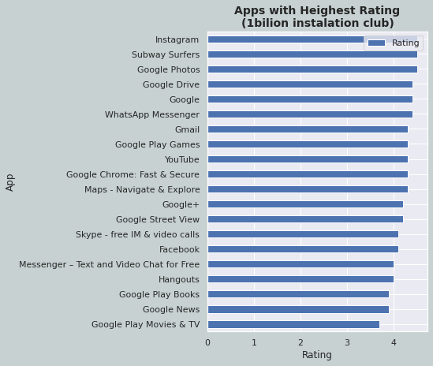
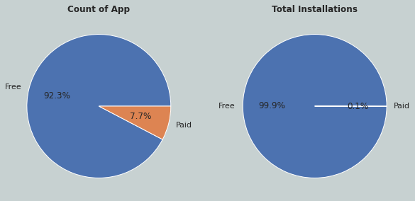
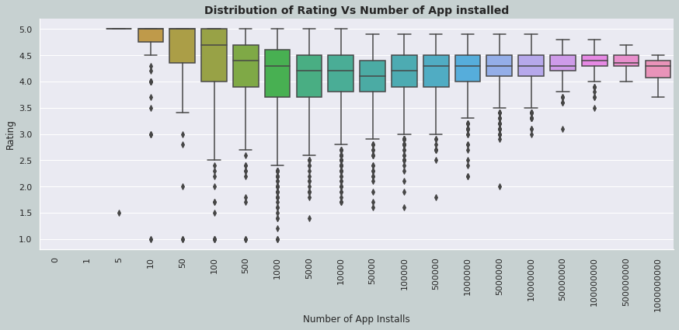
Total number of installations within app and its category

Slide 14
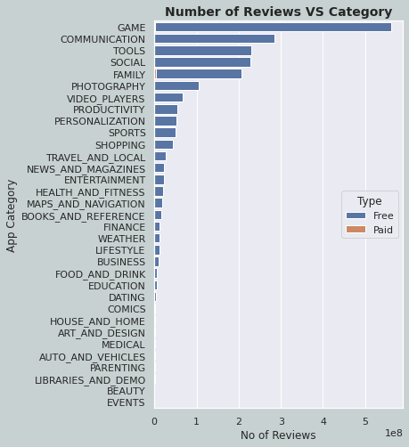
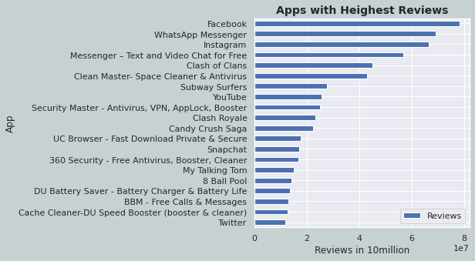
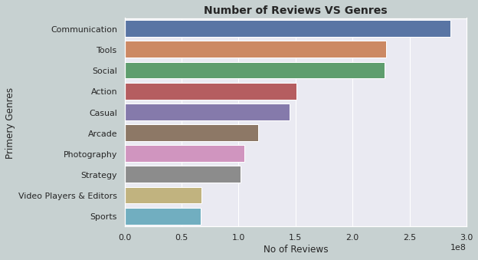
Distribution of reviews within Apps and its category

Slide 15
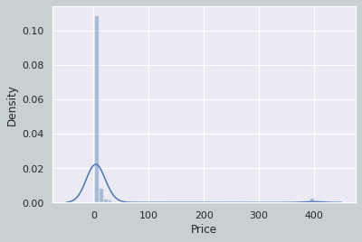
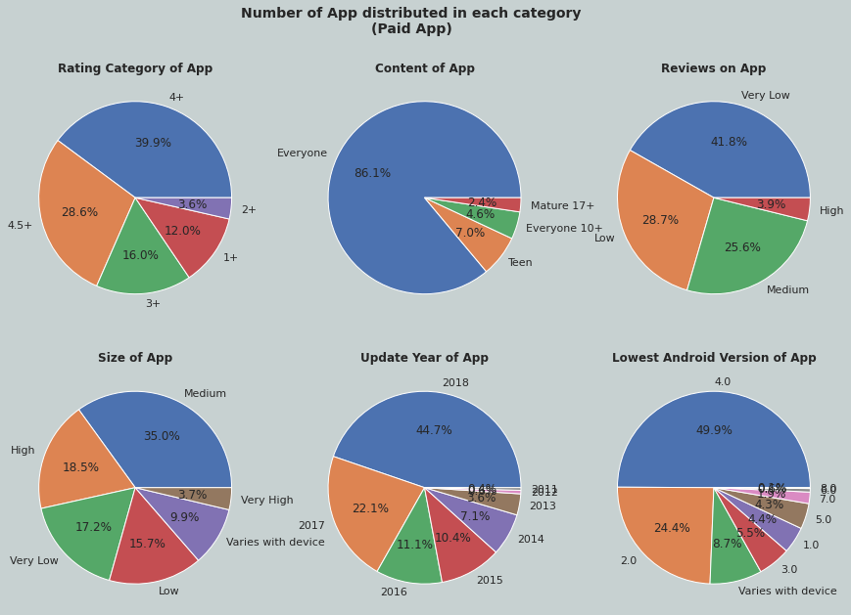
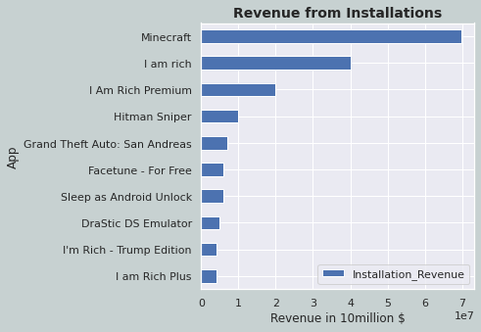
Analysis of Paid Apps

Slide 16
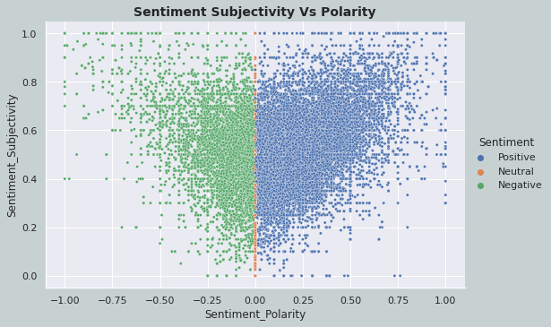
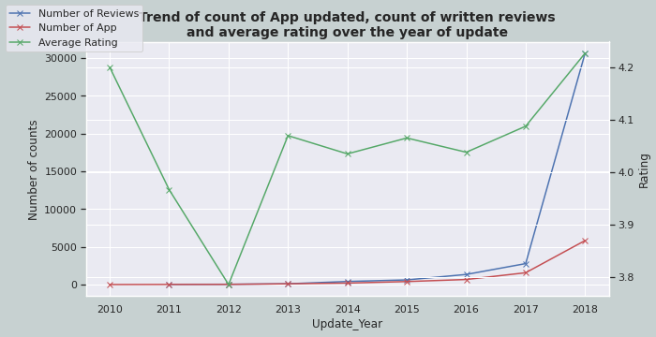
App Review analysis (Overview of written reviews)

Slide 17
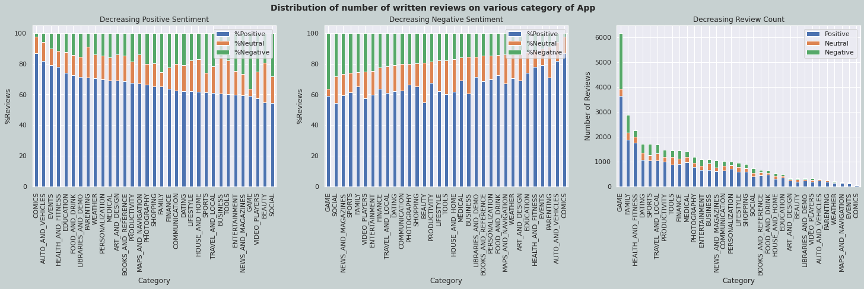
App Review analysis on category of App

Slide 18
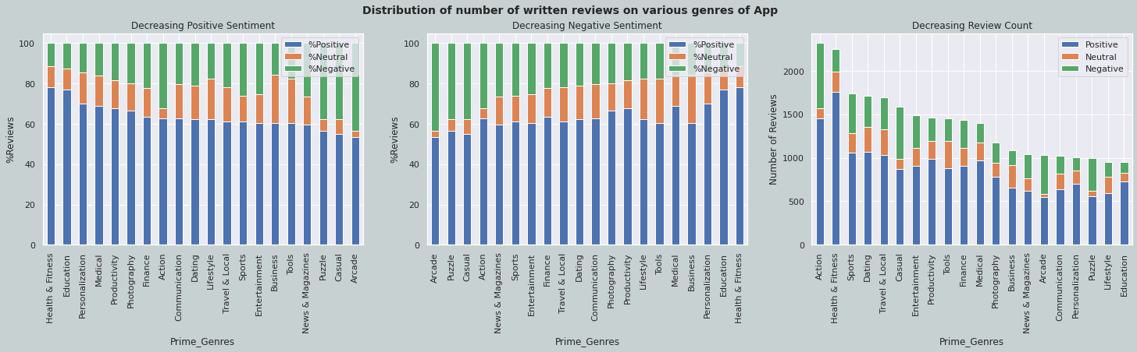
App Review analysis on primary genres of app

Slide 19
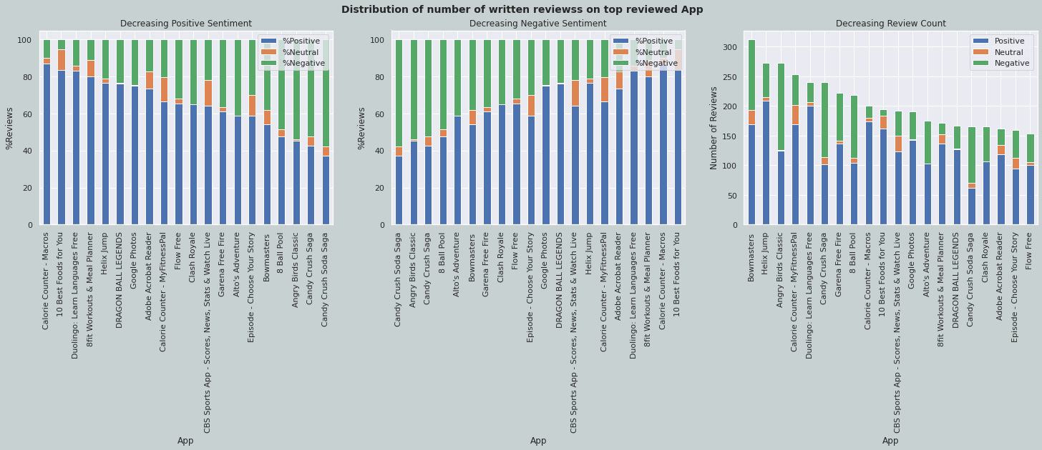
App Review analysis on 20highest reviewed apps

Slide 20
Conclusion
1. Reviews are highly correlated to number of installs
2. Most of app have rating above 3.5.
3. App suitable to everyone has heighst span of rating while app belonging to Adult only have smaller rating span.
4. 92% of total app on app store are free.
5. 81% of total app belongs to category of app suitable to everyone.
6. Only 1.3% of App have rating reviews greater then 4Million.
7. 42.7% of the app have size 5MB to 30MB.
8. Most of the apps are updated in the year 2018, that is most of the app in the dataset are latently updated.
9. Android version 4.0 is the most suitable one for most apps.
10. Game is the most installed category while Event is the least installed category.
11. Contribution of Paid app to Free app in terms of installation is negligible, below 1%.
12. Instagram is the top rated app in 1Billion installation category.
13. Price of paid apps are concentrated on `1$ and 400$.`
14. 86% of the paid app belongs audience category of everyone.
15. Hitman Sniper and Minecraft are top installed paid apps.
16. Minecraft and I am rich were the app that has generated highest revenue through installations or app sale.
17. There is no clear relation between sentiment subjectivity and polarity.
18. Comics, Auto & Vehicles are the top positively reviewed app category considering %of positive from all reviews in the category.
19. Game, Social, News&Magzins are most negatively reviewed category as %of negative on total reviews.
20. Game and Family have most number of written reviews.

Slide 21
Business Outlook and Opportunities
People prefer using free app most, but with advanced engagement features and usability, people are also ready to pay price if price is below 1$.
To increase the scope of number of user it is better to launch app which is suitable for every age of audience.
In order to maintain app relevant with user it is necessary that app is updated regularly. App that is latest updated have more number of users.
Game is the most installed app category at the same time it is the category were %of negative reviews are more then all other category. This appears to be a clear market gap and this category have potential of service improvement.
Event is the least installed app category which should be avoided by new app makers.
Dating is again most underrated category that has the potential room for new app makers.
Game and Family are the top category which are discussed by user or have received written reviews. They holds good ground of interest from users point.
Action, Health&Fitness and Sports are top discussed genres of app.

Slide 22
Refrences
pandas.pydata
matplotlib.org
seaborn.pydata
Tradingeconomics
Statista
Wikipedia
Stack Overflow
W3Schools
Investopidia
Business of Apps
Appypie
Statology
Educba
Tutorialspoint.com
Pythoncharts.com
India.gov.in
companiesmarketcap.com
alltopeverything.com
telecom.economictimes
Sensortower
Businessinsider
TRAI
Geeksforgeeks

Slide 23


Slide 24
CAPSTON PROJECT-1 Play Store App and Review analysis
By
balkrishna Tiwari

